Slide 1
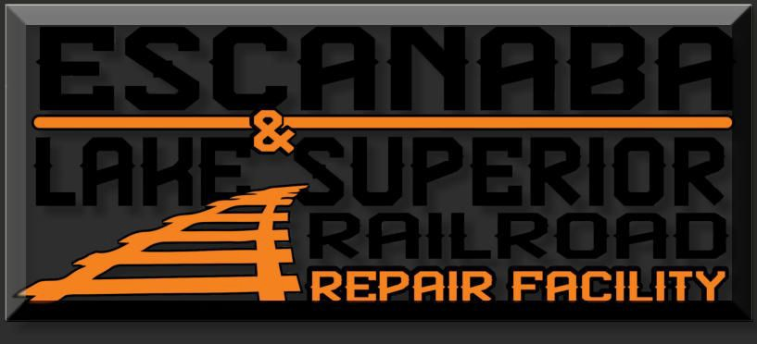
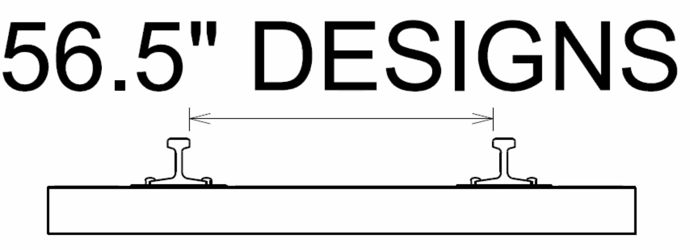


E&LS Storage Track Final Presentation
Alex Christmas Brendan Gardner Max Maloney Jack Seilsopour

Slide 2
Outline
Introduction
Rail Design
Lighting & Drainage Design
Construction Estimates
Conclusion
Questions

Slide 3
Introduction
Max Maloney

Slide 4
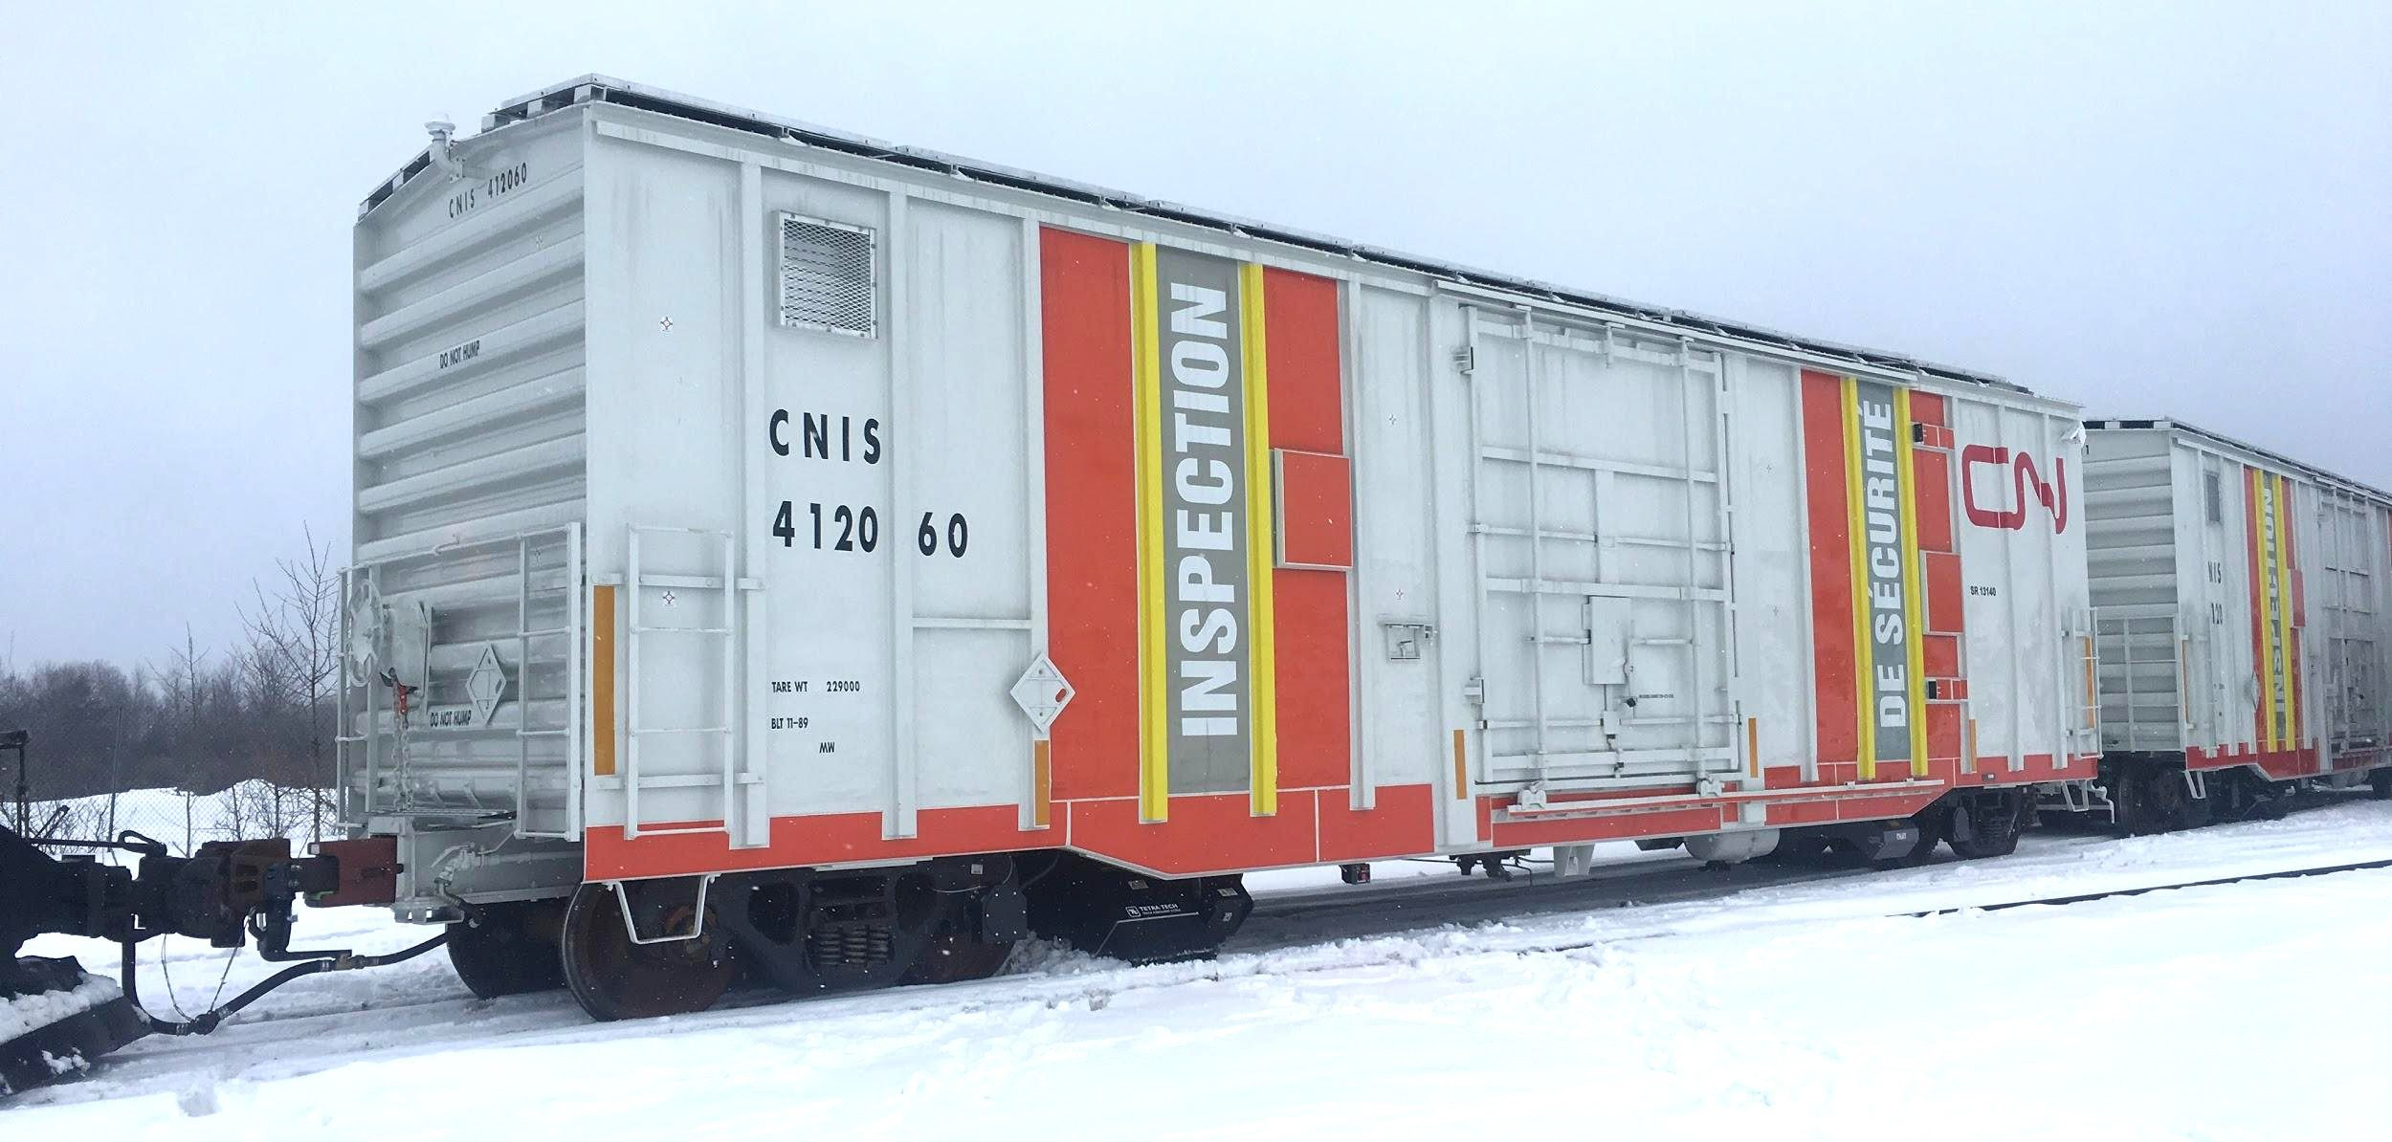
Project Introduction
Escanaba & Lake Superior Railroad
Contract Repair Shop
Existing Site
Railcars need to be stored/staged before shopping
Max Maloney

Slide 5
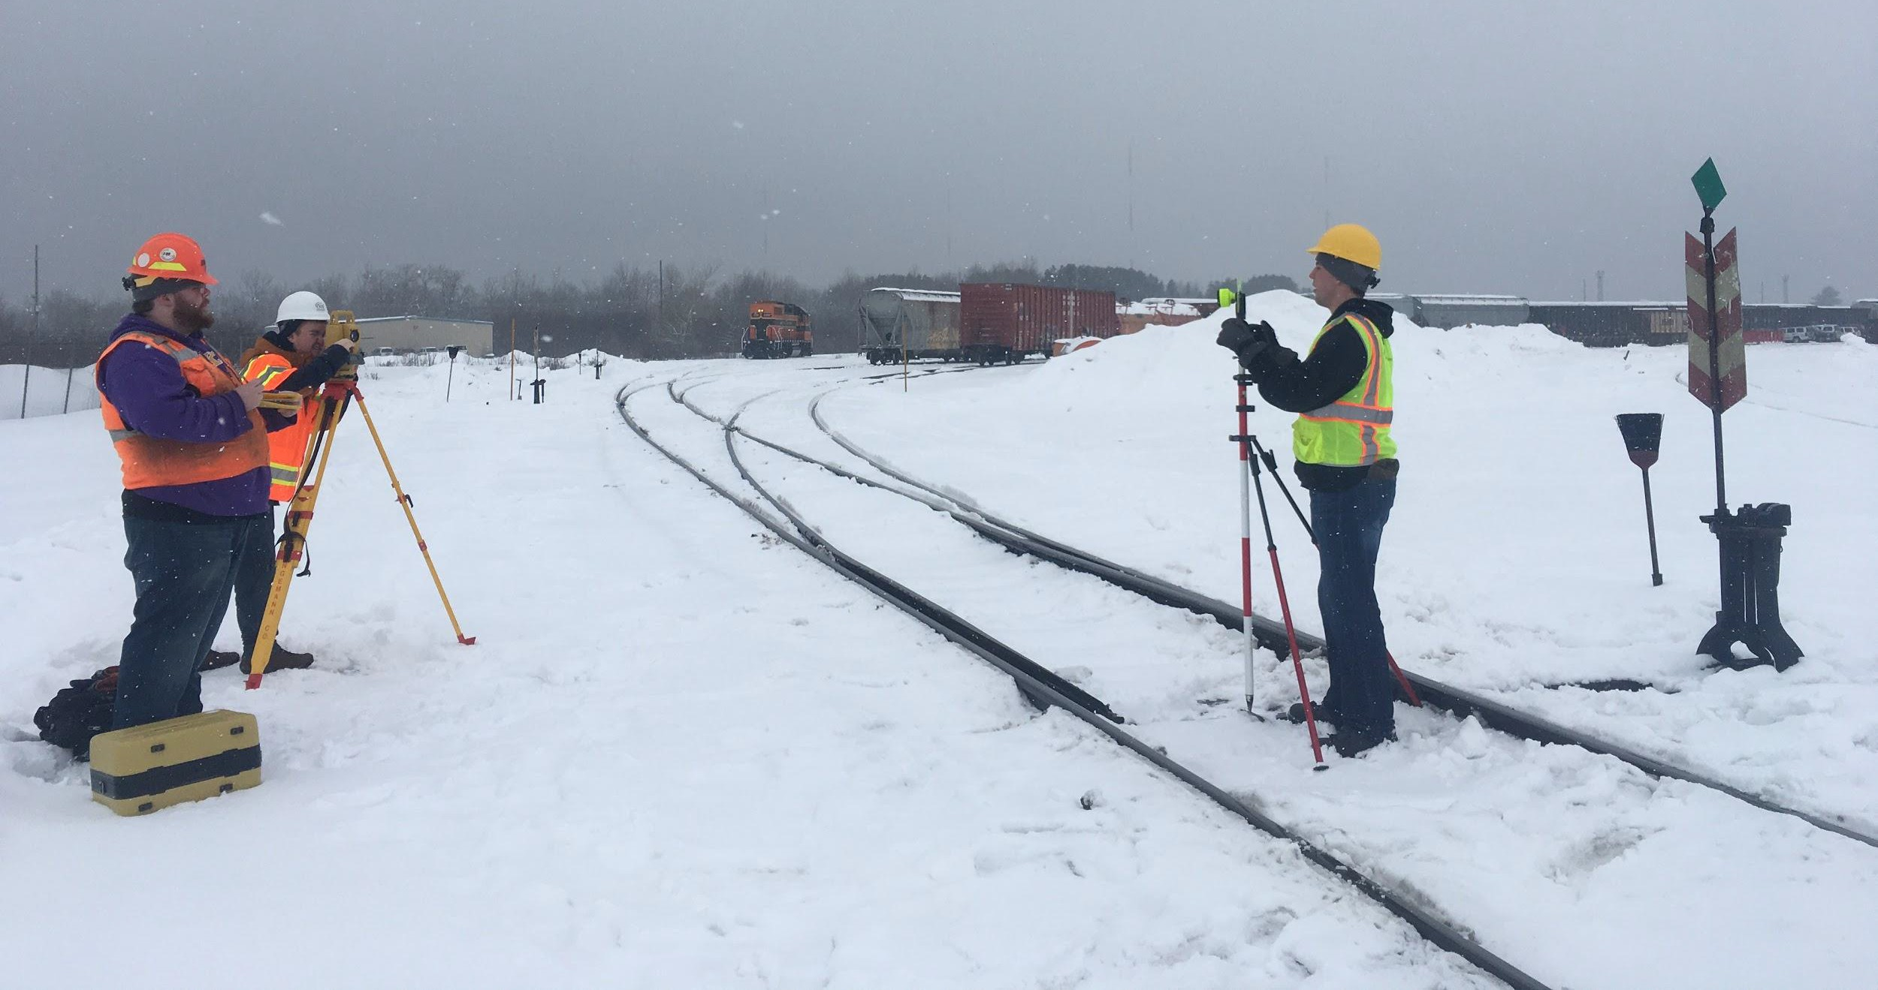
Site Visit & Survey
Site Visit in January
Horizontal Survey
  Existing track
  Turnouts
Generally ﬂat site
Existing track not of high standard
Max Maloney

Slide 6
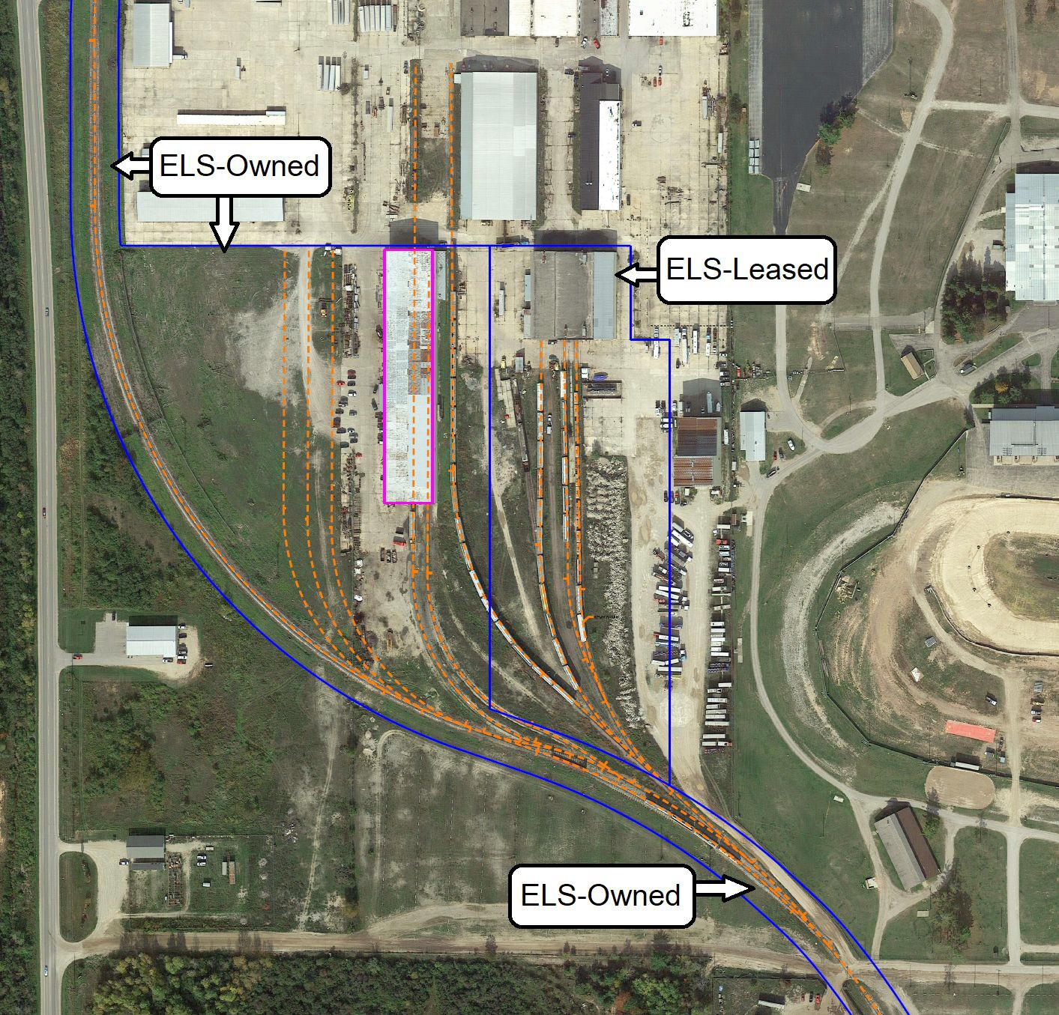
Existing Conditions
E&LS boundary - blue
Existing track - orange
Car shop - pink
Oddly shaped site
Mainline parallel to southern property boundary
Max Maloney

Slide 7
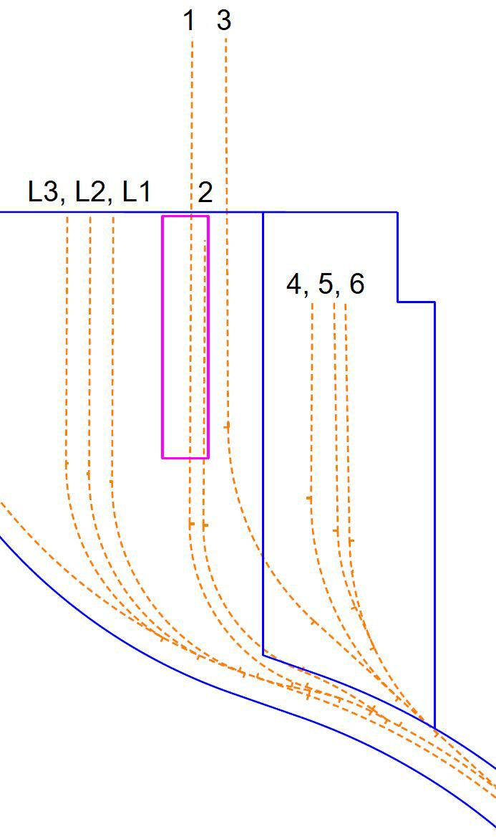
Existing Conditions - Track Capacity
Trk | Length | Cars | Notes
L3 | 883’ | 16 | Staging only
L2 | 930’ | 16 | Staging only
L1 | 985’ | 17 | Staging only
3 | 1063’ | 19 | Access to storage building
4 | 728’ | 13 | Access to 2nd building
5 | 573’ | 10 | Access to 2nd building
6 | 568’ | 10 | Access to 2nd building
Current Capacity: 68 railcars of dedicated space Expansion Goal: add 85 railcars of dedicated space
Max Maloney

Slide 8

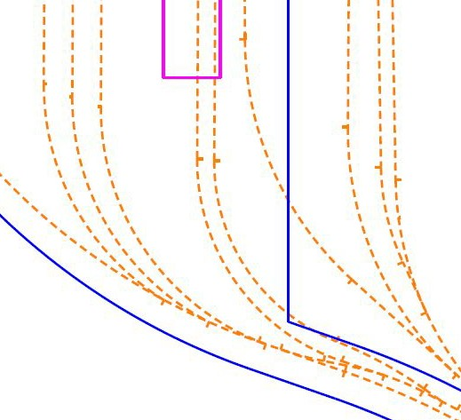
Design Standards
CN Industrial Track Standards
AAR Plate H clearance
envelope
Existing 15.5 and 17-degree curves into car shop
Several curved turnouts
Max Maloney

Slide 9
Track Design
Alex Christmas

Slide 10
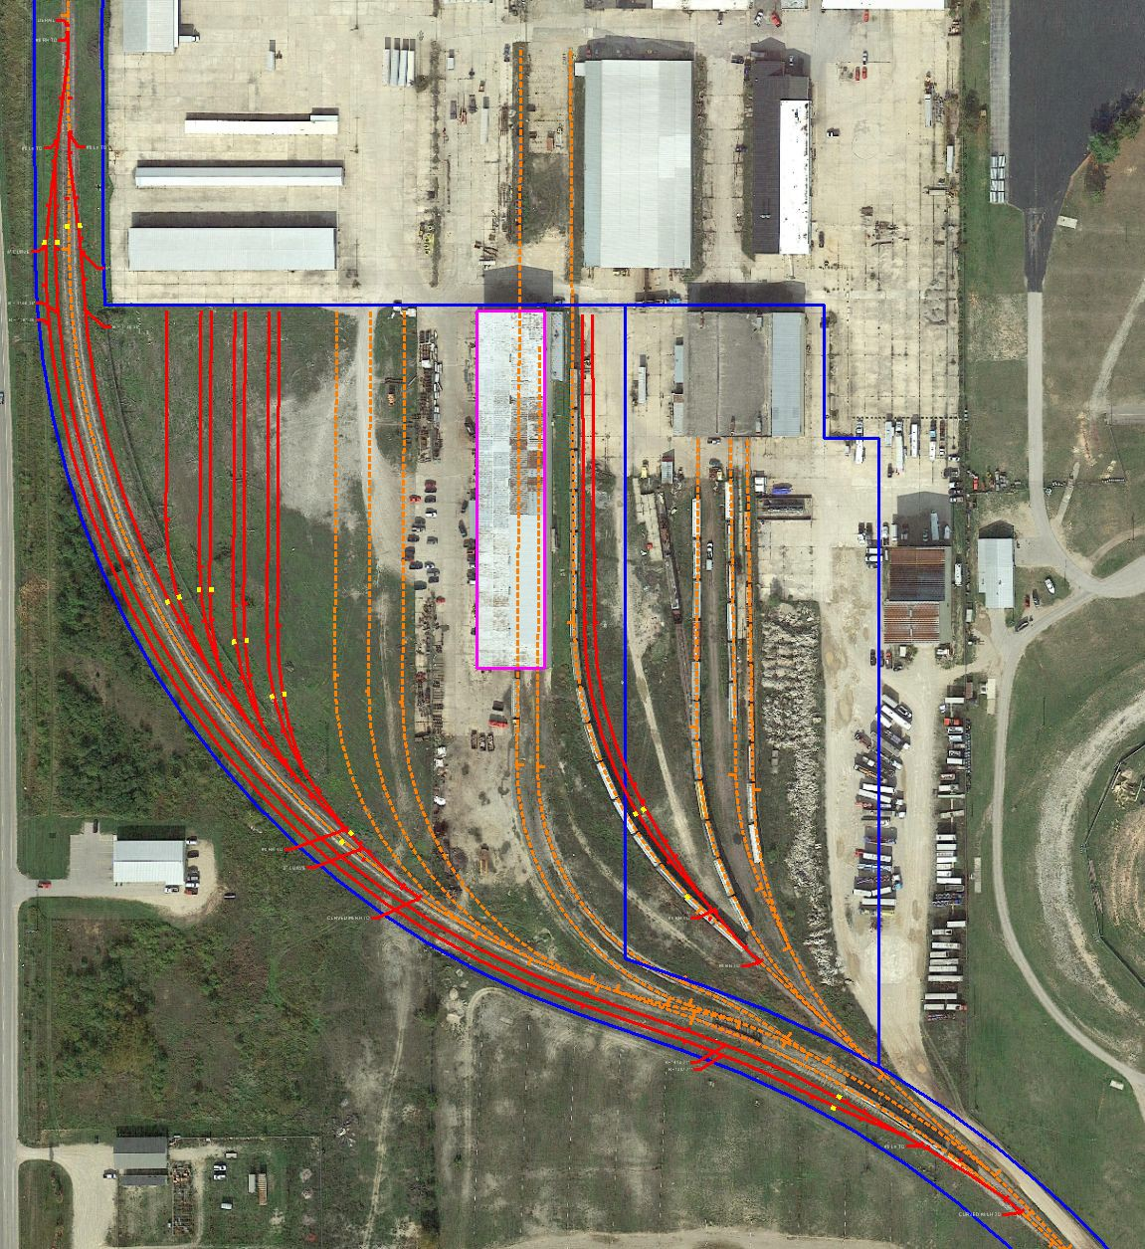
Conceptual Design
Three areas identiﬁed for new track construction
  Two alternatives each
1 Whole-Site
Clean-Sheet Design

Slide 11
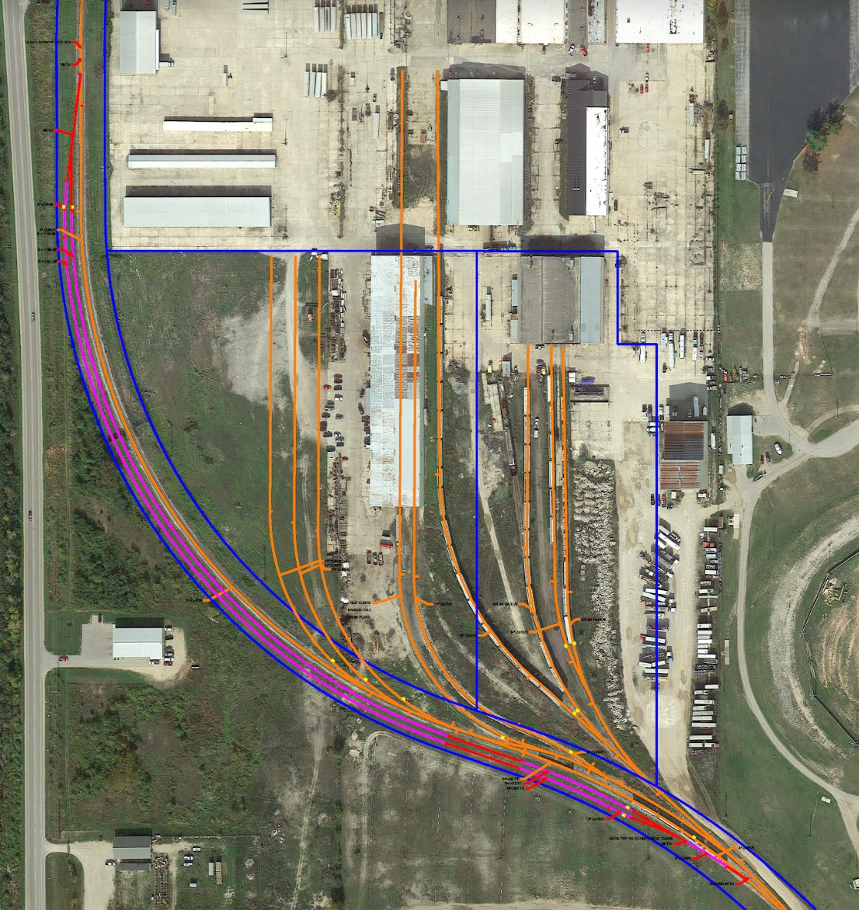
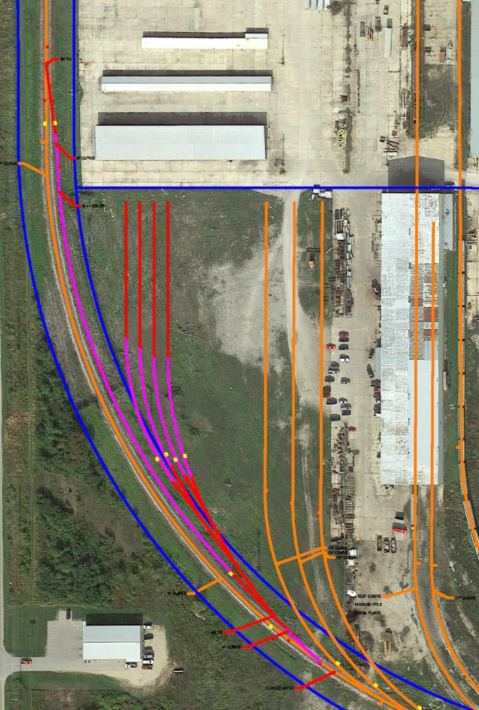
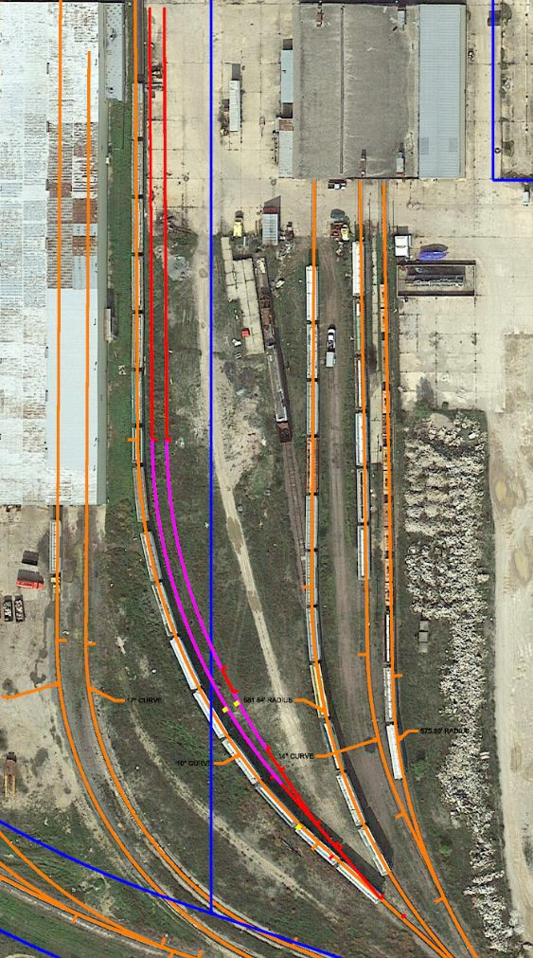
Conceptual Design - Phases 1, 2 & 3

Slide 12
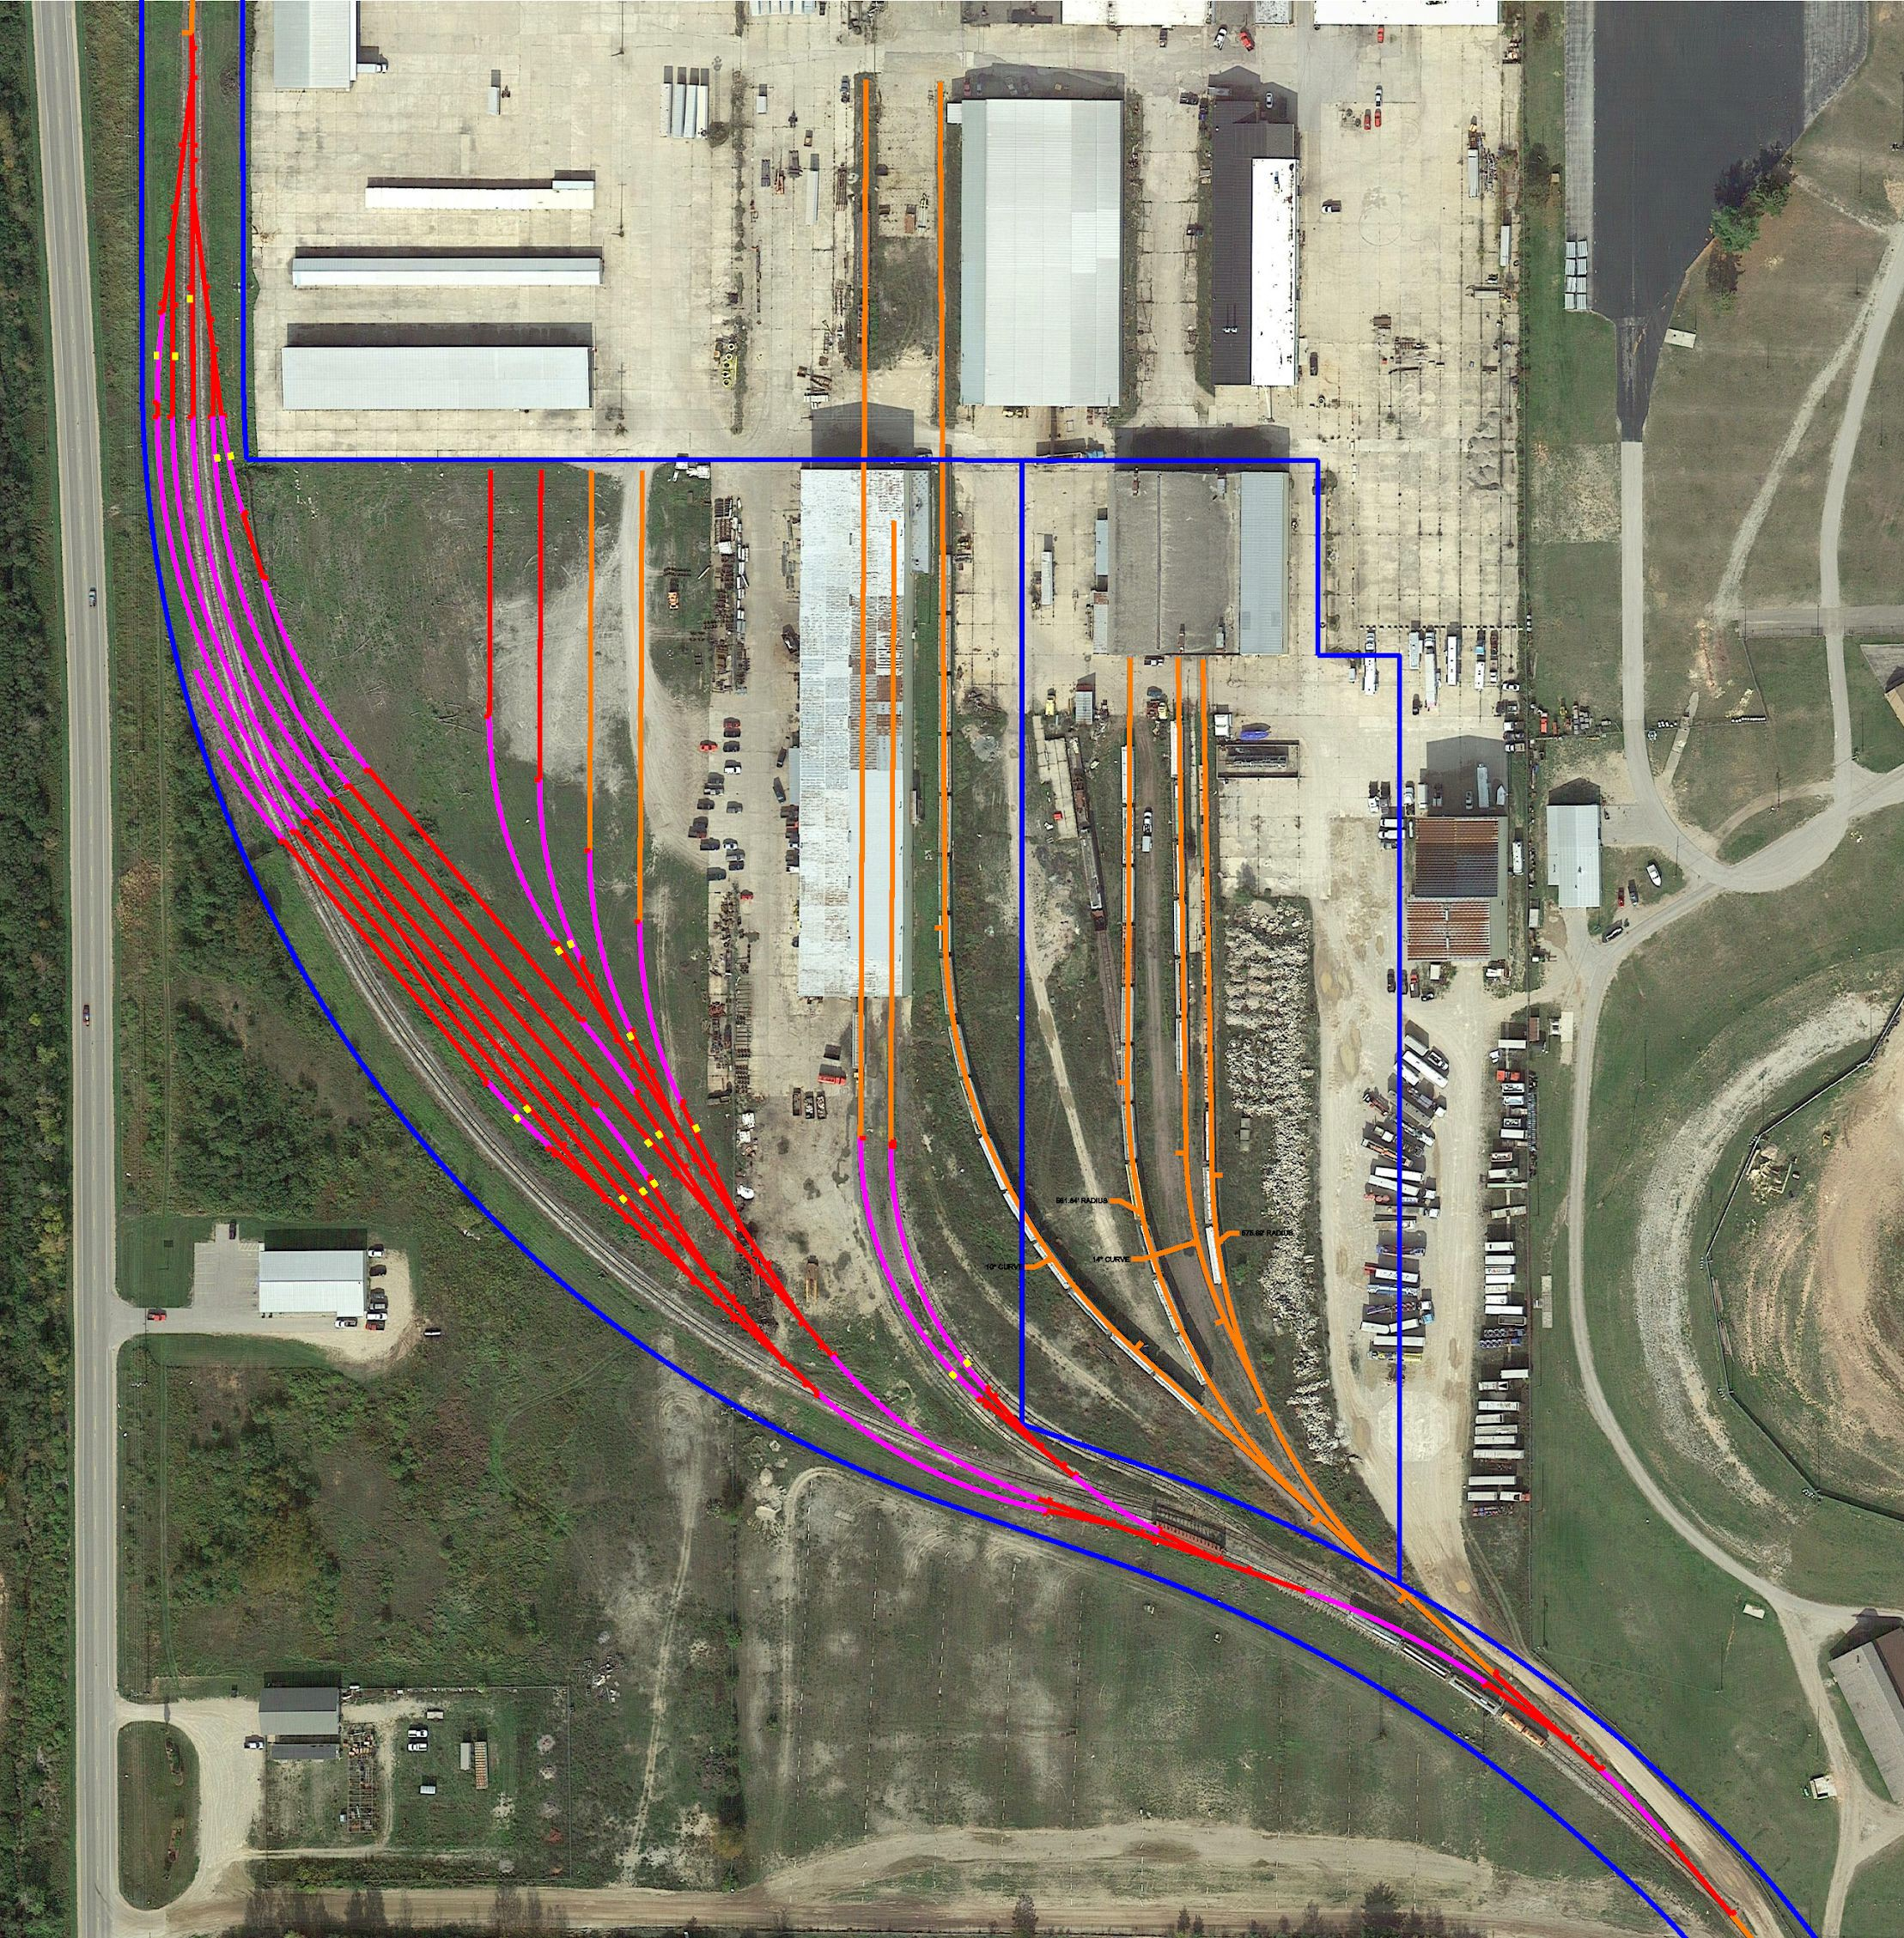
Conceptual Design - Phase 4

Slide 13
Final Design
Phase 1:
  A1-A2: 66 cars of new storage
Phase 2:
  L11: 10-18 cars as a run around
  L10-L4: 57 cars of new storage
Phase 3:
  3A-3B: 26 cars of new storage
New Storage Goal: 85 cars
New Storage Total: 146 cars
Site Total: 214 cars (up 215%)

Slide 14
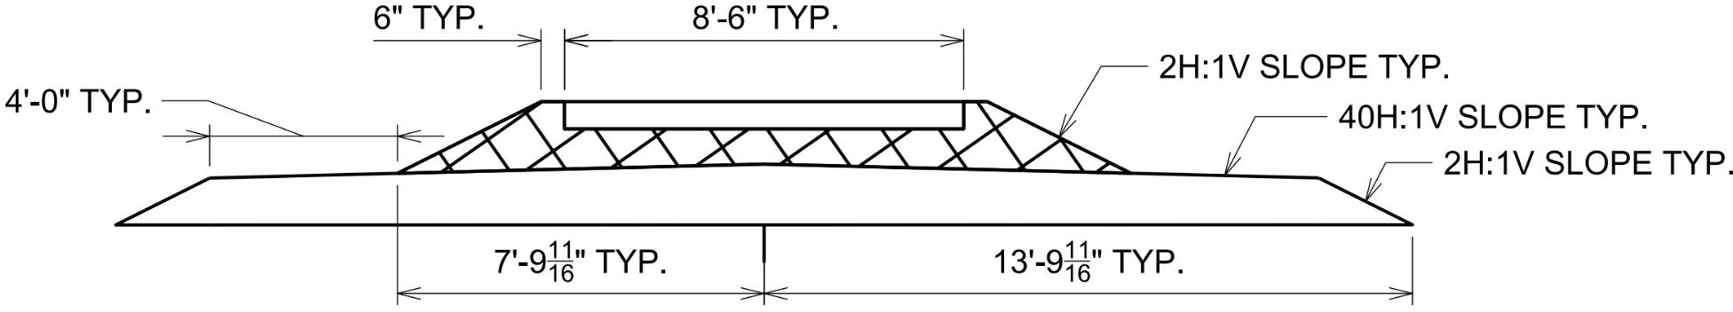
Final Design
Existing Track: ballast lift up to CN standards

Slide 15
Lighting & Drainage Design
Brendan Gardner

Slide 16
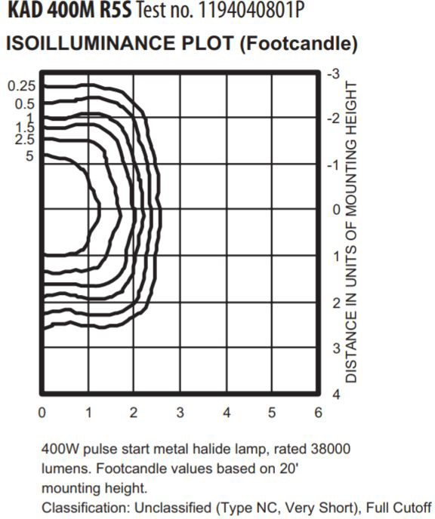
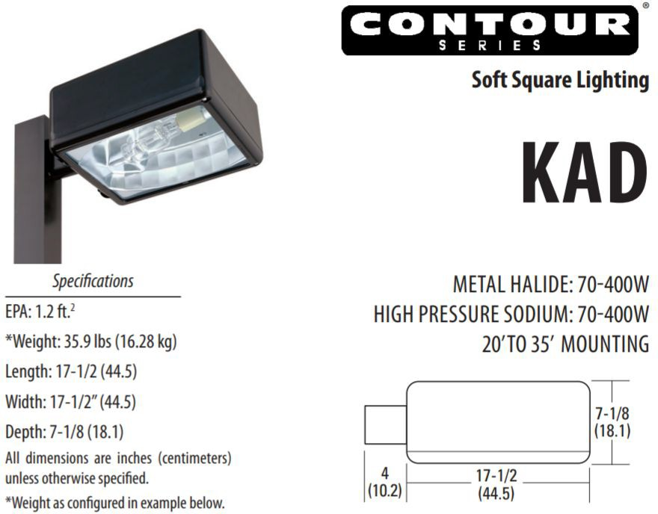
Exterior Lighting Design
US DOE Illumination Recommendations:
  0.2 fc min
  0.5 fc for security
Brendan Gardner

Slide 17
Exterior Lighting Design
US DOE Illumination Recommendations:
  0.2 fc min
  0.5 fc for security
80’ Spacing w/ 40’ poles
Brendan Gardner

Slide 18
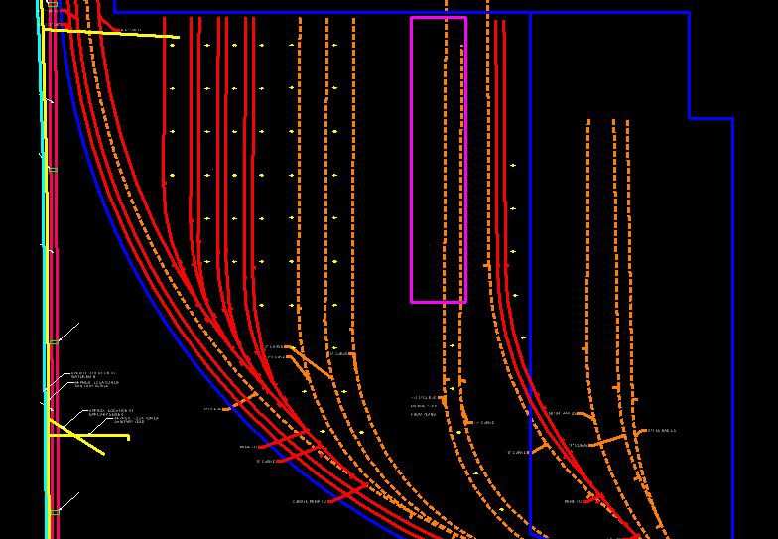
Exterior Lighting Layout Plan
53 poles, 2 ﬁxtures each
CN requires 13.5’ object clearance
  Round up to 15’
on-center spacing to account for pole foundations
Keeps aisleways open for vehicles and snow removal
Brendan Gardner

Slide 19
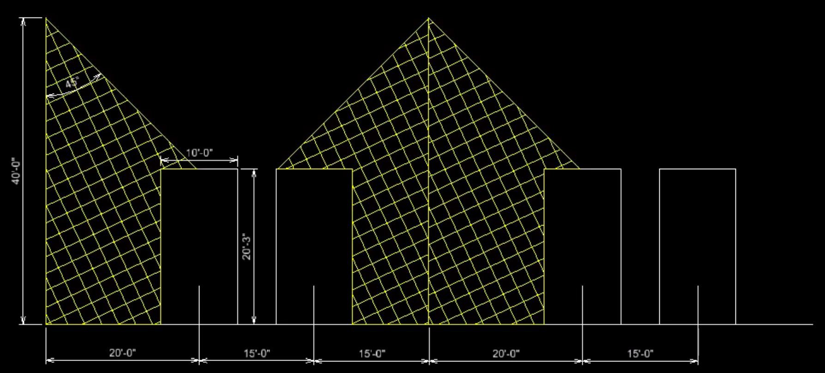
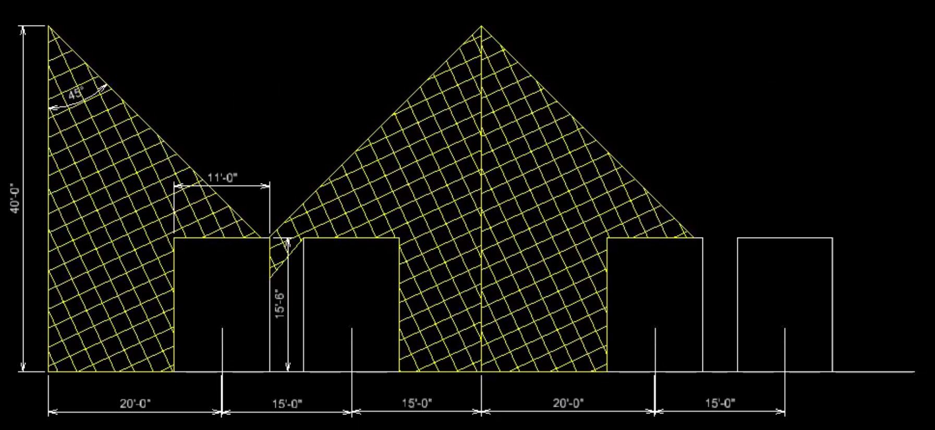
Exterior Lighting Design
Lithonia Lighting model R5
90° cone of useful light
Diagrams at right show lighting areas for diﬀerent AAR clearance envelopes
  Full illumination in aisles
  Shadows occur between track pairs when occupied
Plate H
Plate C
Brendan Gardner

Slide 20
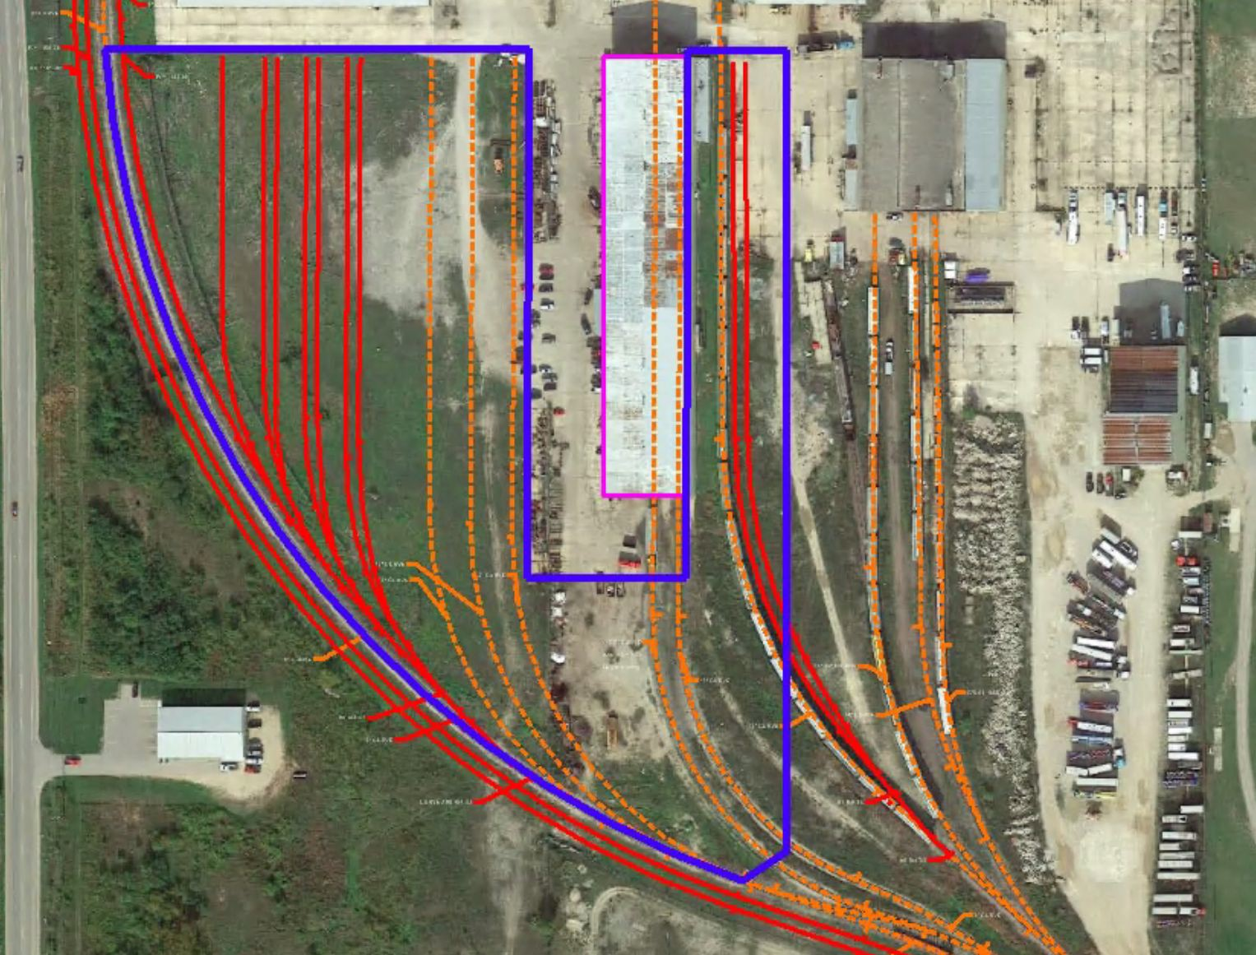
Drainage Design
471,800 SF drainage area
Sandy underlying soils
100-year, 24-hour storm: 5” of precipitation
Runoﬀ:
  2.54” for avg soil moisture
  4.11” for high soil moisture
Brendan Gardner

Slide 21
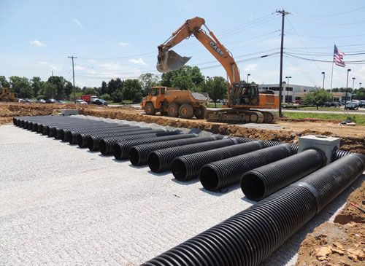
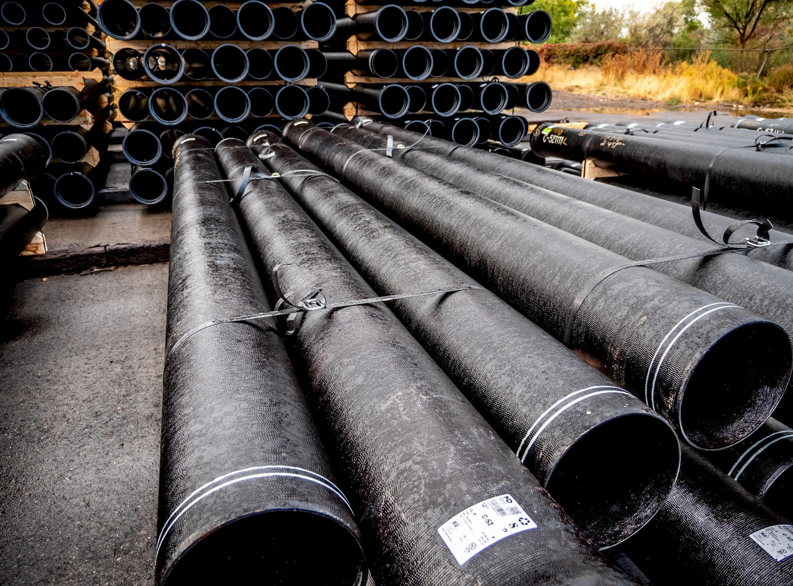
Drainage Design
Underground Detention Basin
  HDPE perforated pipe
HDPE feeder lines
Ductile Iron Pipe under track
Brendan Gardner

Slide 22
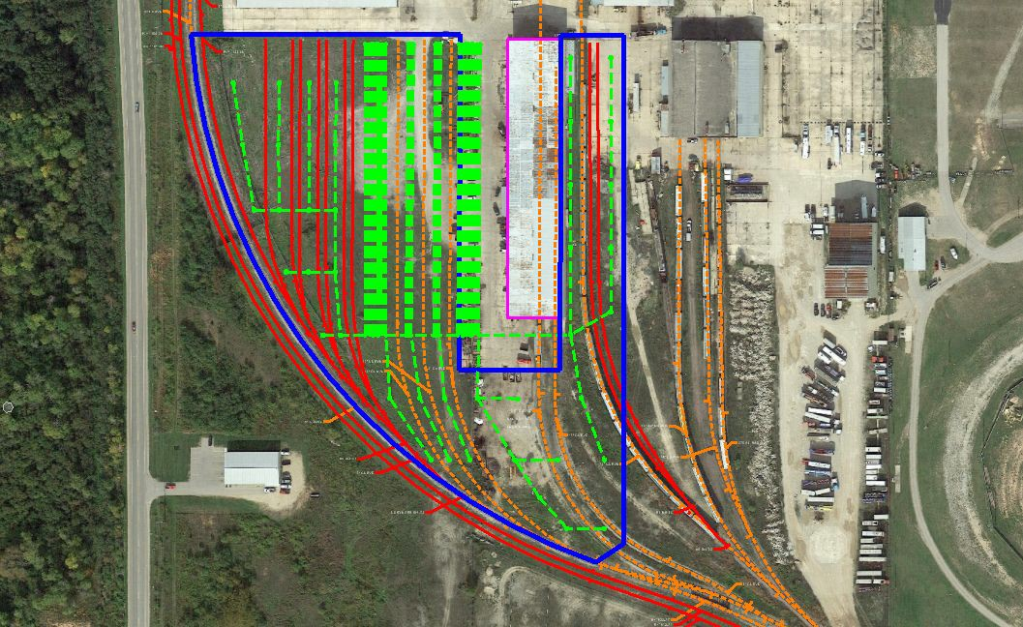
Drainage Design
4’ HDPE perforated pipe
5’ pipe centers
Underground Basin
  High soil moisture: 12890’
  Avg soil moisture: 7960’
Brendan Gardner

Slide 23
Drainage Design
4’ HDPE perforated pipe
5’ pipe centers
Underground Basin
  High soil moisture: 12890’
  Avg soil moisture: 7960’
Brendan Gardner

Slide 24
Drainage Further Considerations
Soil Testing
  Water Table & Inﬁltration
Runoﬀ assumptions
  High v Avg soil moisture?
Bottomless catch basins
  Higher inﬁltration?
Outlet?
May be acceptable as-is
Brendan Gardner

Slide 25
Estimating
Jack Seilsopour

Slide 26
Estimate Assumptions
Track Materials
  All-New
    Direct from manufacturer
  Relay Condition
    Previous use elsewhere, purchased by E&LS
  On-Hand
    Previous use elsewhere, already owned by E&LS
Lighting and Drainage
  All-New

Slide 27
Estimate Assumptions
Equipment
  Rental Rates
Labor
  MDOT Prevailing Wage
  RS Means Crews
Sources:
  RS Means
  Heavy Rail Suppliers

Slide 28
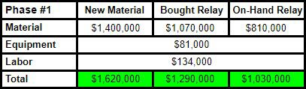
Construction Estimates
Phase One - 4,032’
  Total - $1.6M
  Duration ~ 65 Days

Slide 29
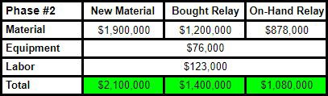
Construction Estimates
Phase Two - 4,376’
  Total - $2.1M
  Duration ~ 60 Days

Slide 30
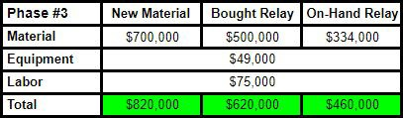
Construction Estimates
Phase Three - 1,660’
  Total - $824K
  Duration ~ 40 Days

Slide 31


Construction Estimates
Lighting and Drainage
  Total - $2.1M
  Duration ~ 52 Days
Existing Track Raise
  Total - $2.9M
  Duration ~35 Days

Slide 32
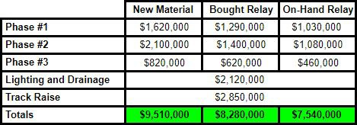
Construction Estimates
Construction Estimate Summary
  Total Cost - $9.5M
  Total Duration ~ 252 Days
Relay material can lower price by $1.2M
On-Hand material can lower price by $2.0M

Slide 33
Acknowledgements
Mike Logan - Client
Daniel Block - Client
Jason Campbell - Client
Dave Nelson - Advisor
Terry Flower - City of Escanaba
Jim Sharpe - Sharpe Engineering
Joseph Foster - MTU Surveying Instructor

Slide 34
Questions?
Alex Christmas Brendan Gardner Max Maloney Jack Seilsopour

Slide 35
Questions?

